Slide 1

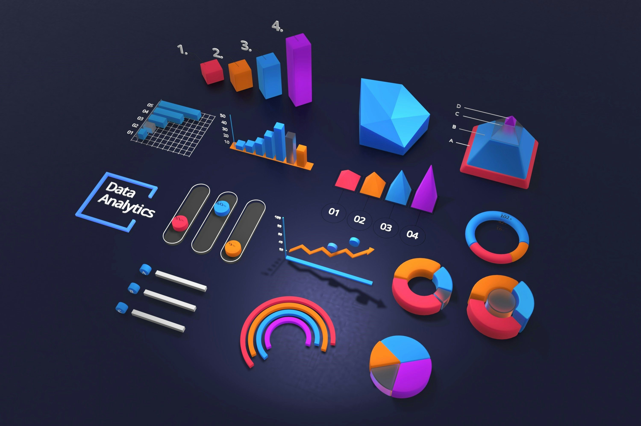





Tools & Technologies

Slide 2



Tools & Technologies
Tools & Technologies

Slide 3
Power Bi
Power BI is a suite of business analytics tools that deliver insights throughout your organization. It helps in connecting to hundreds of data sources, simplifying data preparation, and driving ad hoc analysis. With Power BI, users can produce beautiful reports and publish them for their organization to consume on the web and across mobile devices.
Tools & Technologies

Slide 4
Google Colab
Google Colab is an online Jupyter notebook environment hosted by Google. It allows users to write and execute Python code directly in their web browser, making it accessible from any device with an internet connection. Colab provides the computational resources, such as CPUs and GPUs, required to run code efficiently, which is especially beneficial for tasks involving large datasets and complex computations.
Tools & Technologies

Slide 5
Python Libraries
Pandas is a powerful, open-source data manipulation and analysis library for Python. It provides data structures and functions needed to manipulate numerical tables and time series data.
Matplotlib is a comprehensive library for creating static, animated, and interactive visualizations in Python. It is highly customizable and widely used for creating publication-quality plots and graphs.
Seaborn is a Python data visualization library based on Matplotlib that provides a high-level interface for drawing attractive and informative statistical graphic
BeautifulSoup is a Python library used for web scraping purposes to pull the data out of HTML and XML files.
Tools & Technologies

Slide 6
Excel
Microsoft Excel is a spreadsheet program that allows users to organize, format, and calculate data using a system of rows and columns. It is a versatile tool that can be used for various purposes, including data analysis, financial modelling, project management, and more. Excel's interface consists of a grid of cells, each of which can contain numbers, text, formulas, or functions.
Tools & Technologies

Slide 7
Power Query
Power Query is a data transformation and data preparation engine. It allows users to extract data from various sources, transform it to meet their needs, and load it into Excel or Power BI for further analysis. Power Query provides an intuitive, userfriendly interface for data manipulation, making it accessible to both technical and non-technical users.
Tools & Technologies

Slide 8
Jira
Jira is a comprehensive and flexible project management tool that supports various methodologies and use cases. Its powerful features for issue tracking, agile project management, collaboration, and reporting make it an essential tool for software development teams and organizations managing complex projects. Whether you are tracking bugs, planning sprints, or managing business processes, Jira provides the tools and capabilities needed to streamline your workflows and achieve your project goals.
Tools & Technologies

Slide 9
Git Hub
GitHub is an essential tool for modern software development, providing powerful version control, collaboration, and project management capabilities. Its wide range of features, active community, and seamless integrations make it an invaluable resource for developers, teams, and organizations working on projects of all sizes and complexities. Whether you are developing proprietary software, contributing to open-source projects, or managing a complex development pipeline, GitHub offers the tools and support needed to succeed.
Tools & Technologies

Slide 10
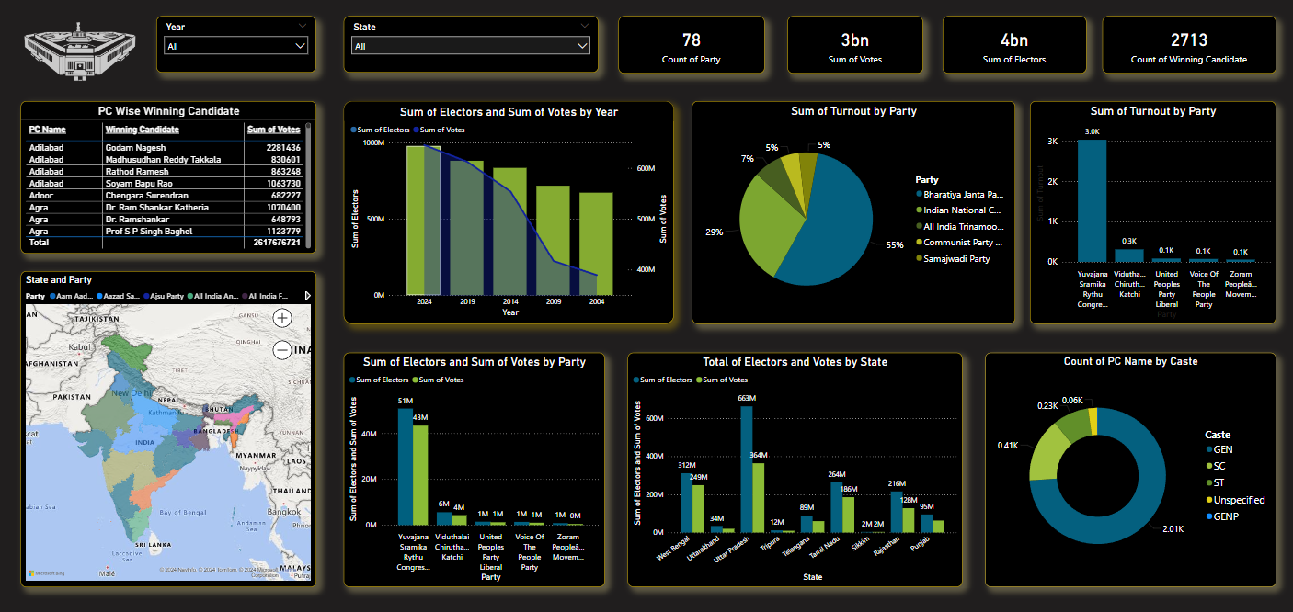
Dashboard
This dashboard provides an analysis of Indian election data, featuring various visualizations. Key metrics include vote counts, elector counts, and winning candidates by year, state, party, and caste. The visualizations include bar charts, pie charts, and a map to illustrate geographic distribution. The data spans from 2004 to recent elections, highlighting trends in voter turnout and party performance. Additionally, the dashboard shows the total votes and electors by state, offering insights into regional variations. It also breaks down the count of winning candidates by caste, showing the representation across different demographics. Overall, this comprehensive analysis aids in understanding the electoral landscape and voter behaviour in India.

Slide 11
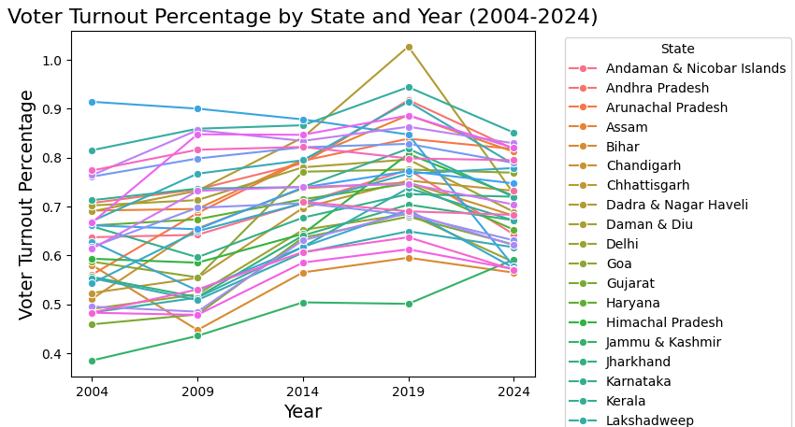
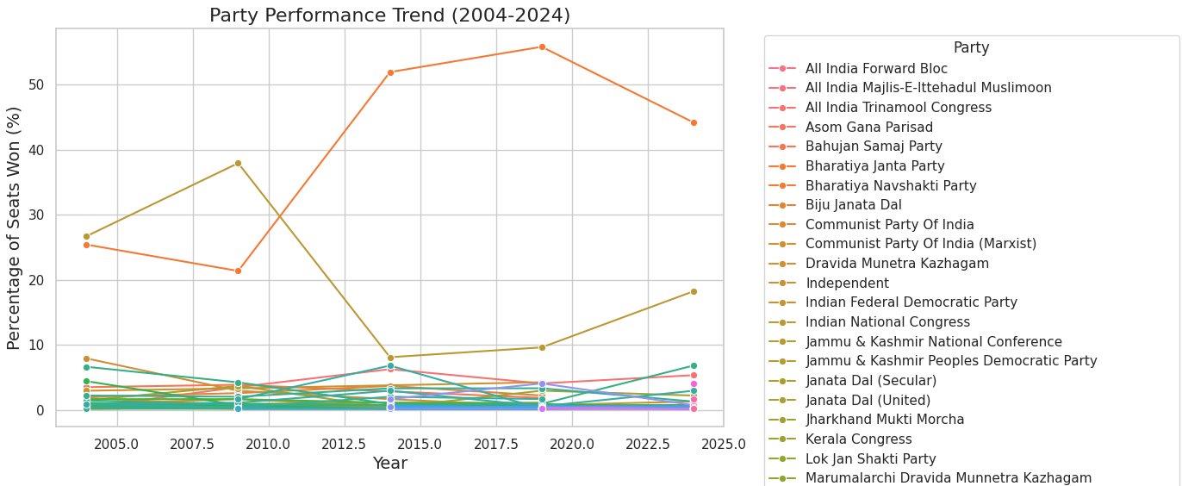
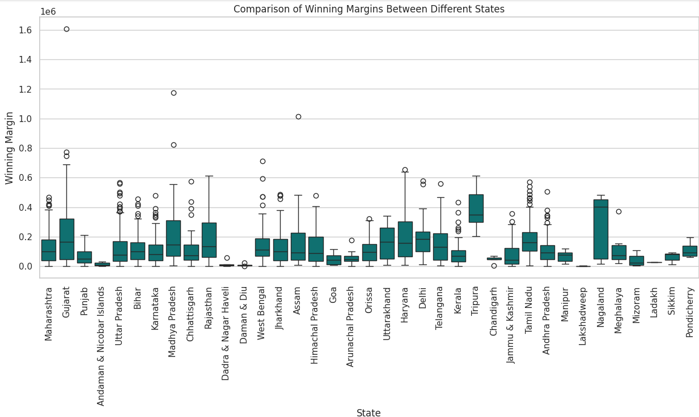
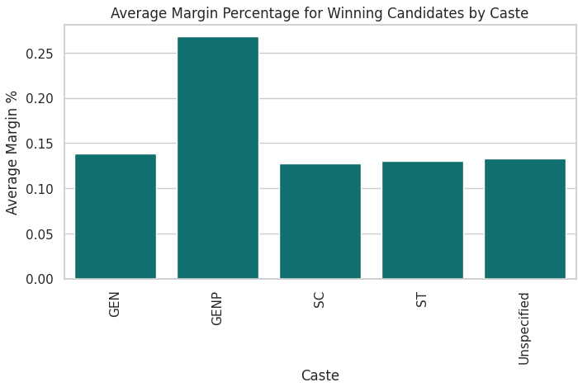

Slide 12
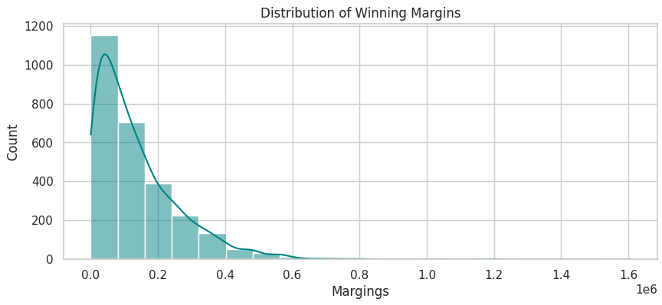

Slide 13
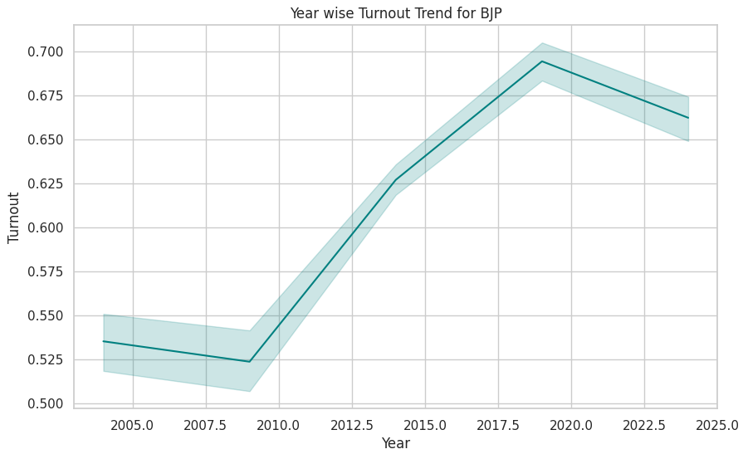

Slide 14
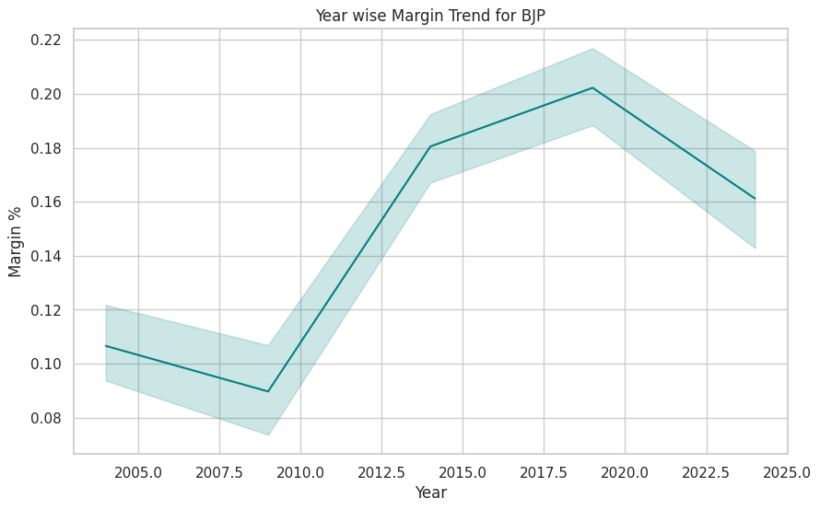

Slide 15
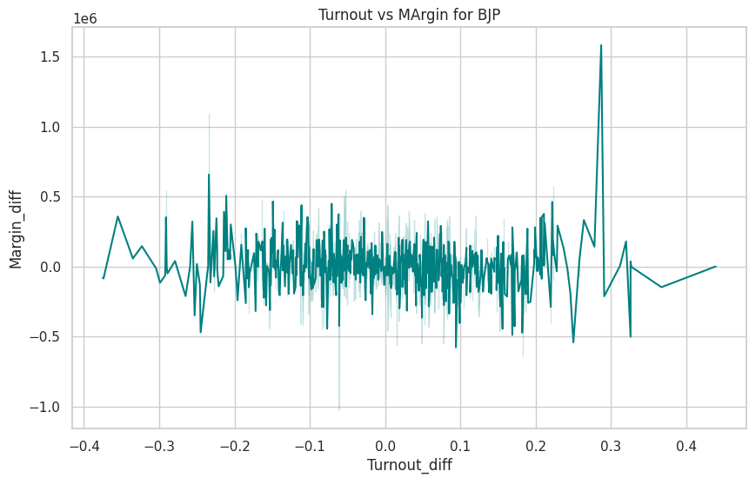

Slide 16
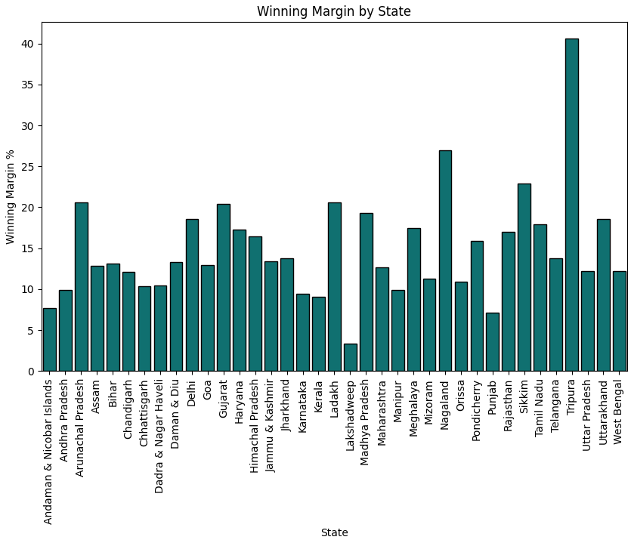

Slide 17
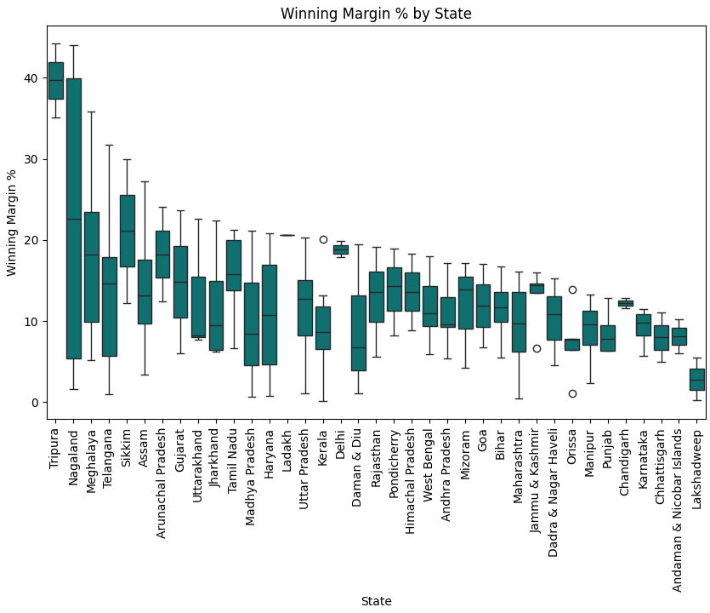

Slide 18
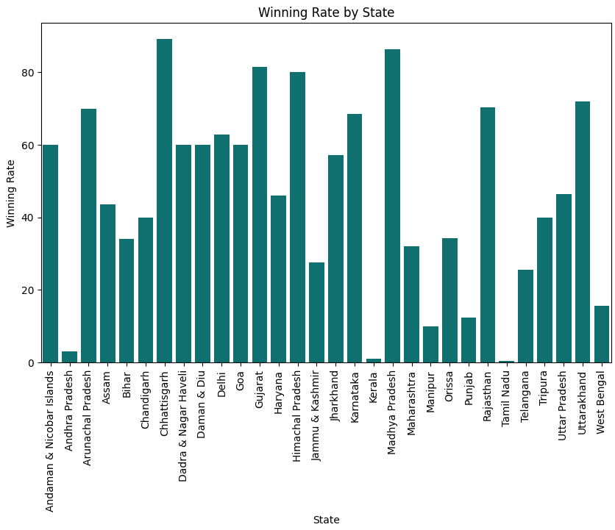

Slide 19
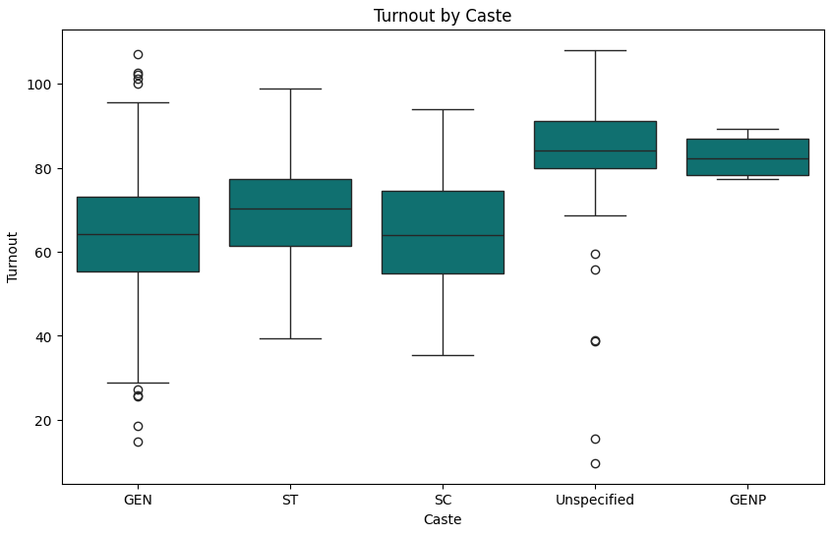

Slide 20
